Slide 1
Analytic Views

Slide 2
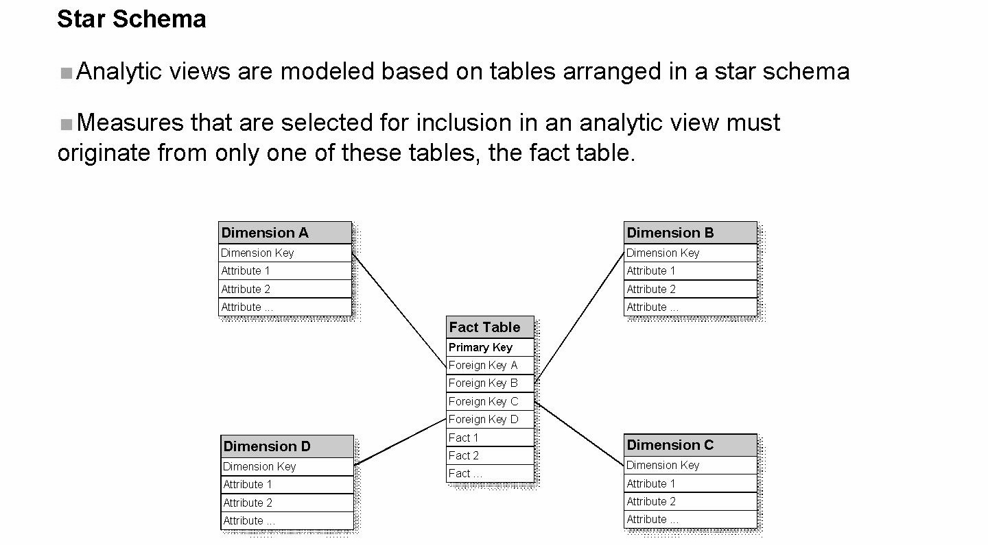
Star Schema
Analytic views can be simply a combination of tables that contain both attribute data and measure data

Slide 3
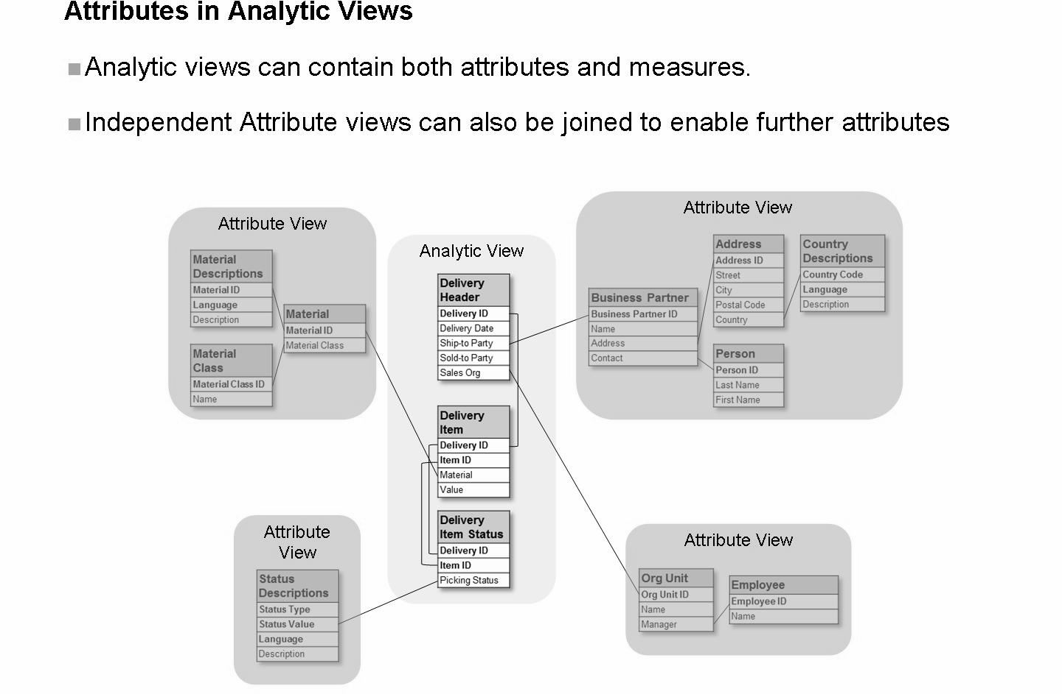
Optionally, attribute views can also be included in the analytic view definition. In this way, you can achieve additional depth of attribute data. The analytic view inherits the definitions of any attribute views that are included in the definition.

Slide 4
Analytic views are used to model data that includes measures
Leverage the fastest types of information model available in SAP HANA to calculate aggregate data
Measures defined on only one fact table
Fact tables can be joined to allow access to more detailed data using a single analytic view as long as the facts (measures) come from a single table
Can be defined in a single table, or in joined table
The attributes or measures marked as hidden are not available for input parameters, variables, consumers or higher level views that are build on top of the analytic view.

Slide 5
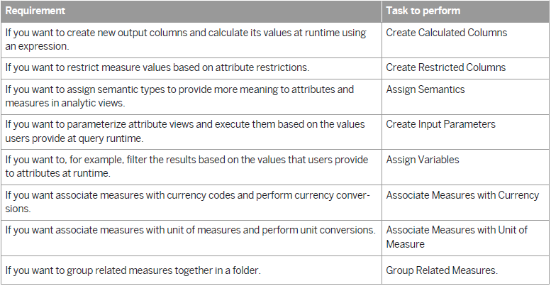
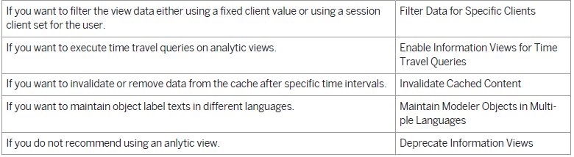

Slide 6
Attributes and measures form content data that you use for data modeling. The attributes represent the descriptive data such as city and country and the measures represent quantifiable data such as revenue and quantity sold.
Information views can contain two types of columns, the measures and the attributes. Measures are columns for which you define an aggregation. If information views are used in SQL statements, then you have to aggregate the measures.
3 Types of Columns
• Columns
• Calculated Columns
• Restricted Columns
- is restricted based on one or more columns (attributes from base table or view).

Slide 7
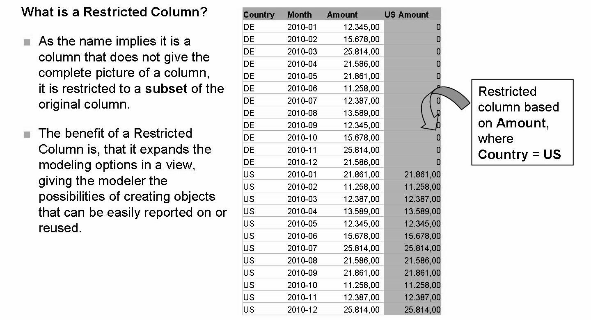
Creating Restricted Columns

Slide 8
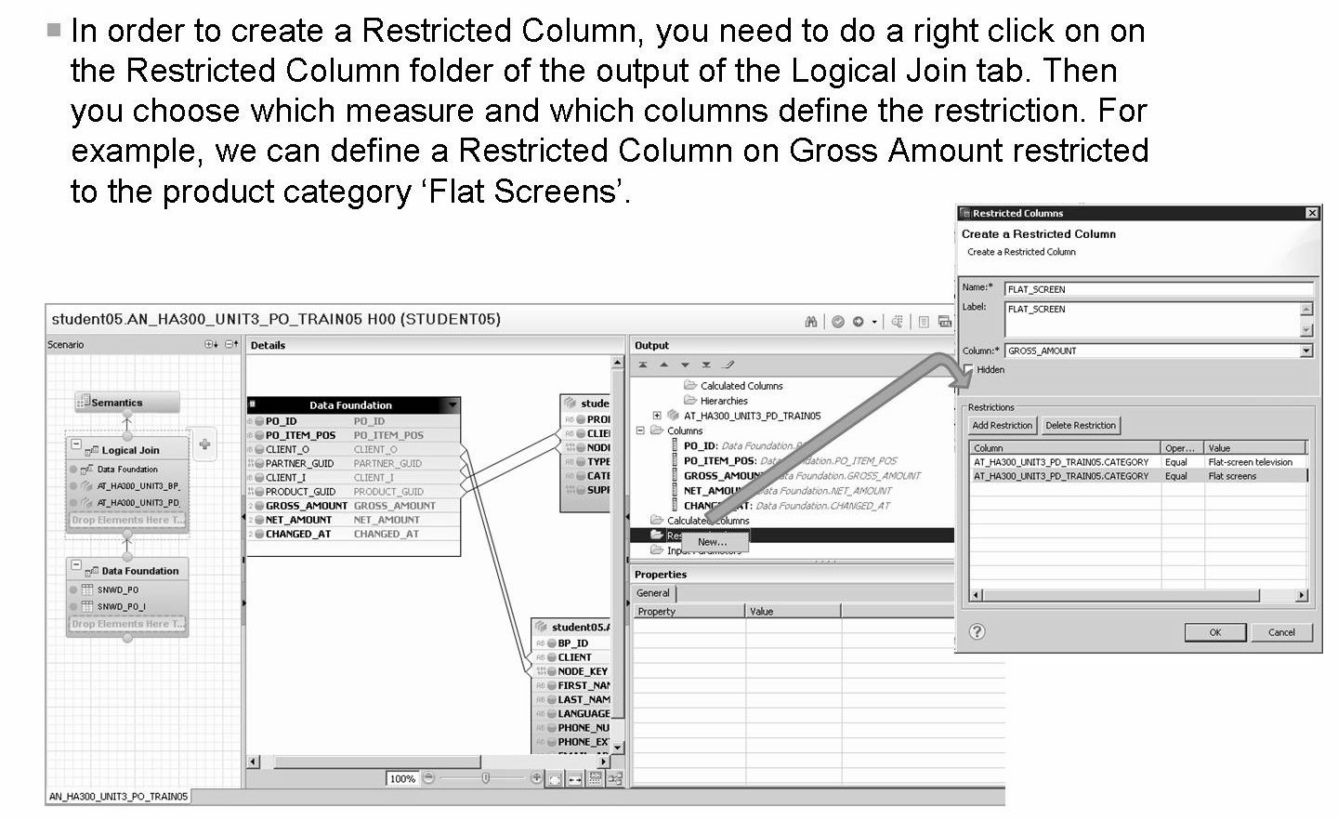
Creating Restricted Columns
You can apply restrictions using more than one attribute column.
You can also use input parameters in your expressions to create restricted columns.

Slide 9
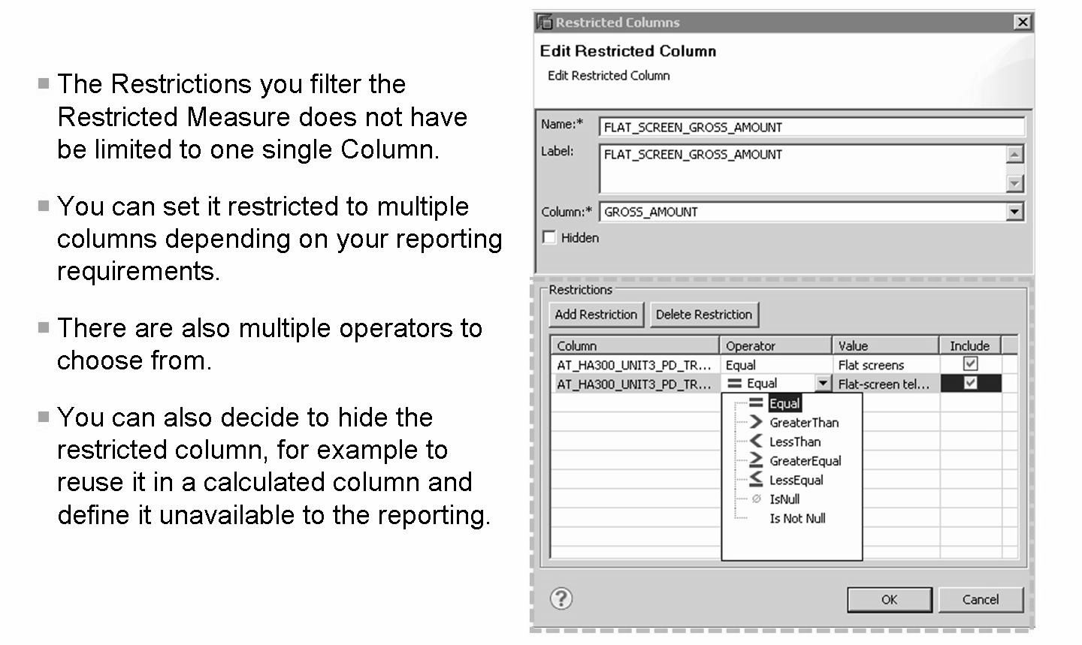
Creating Restricted Columns

Slide 10
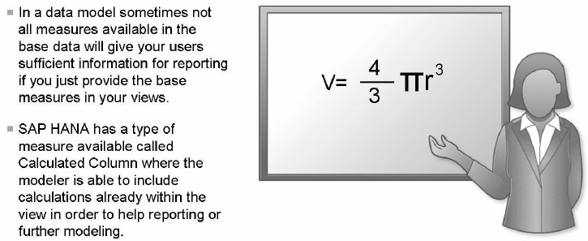
When to use Calculated Columns
A Calculated Column does not have to be a complicated formula like the one shown in the example illustration, it can also be a simple calculation.

Slide 11
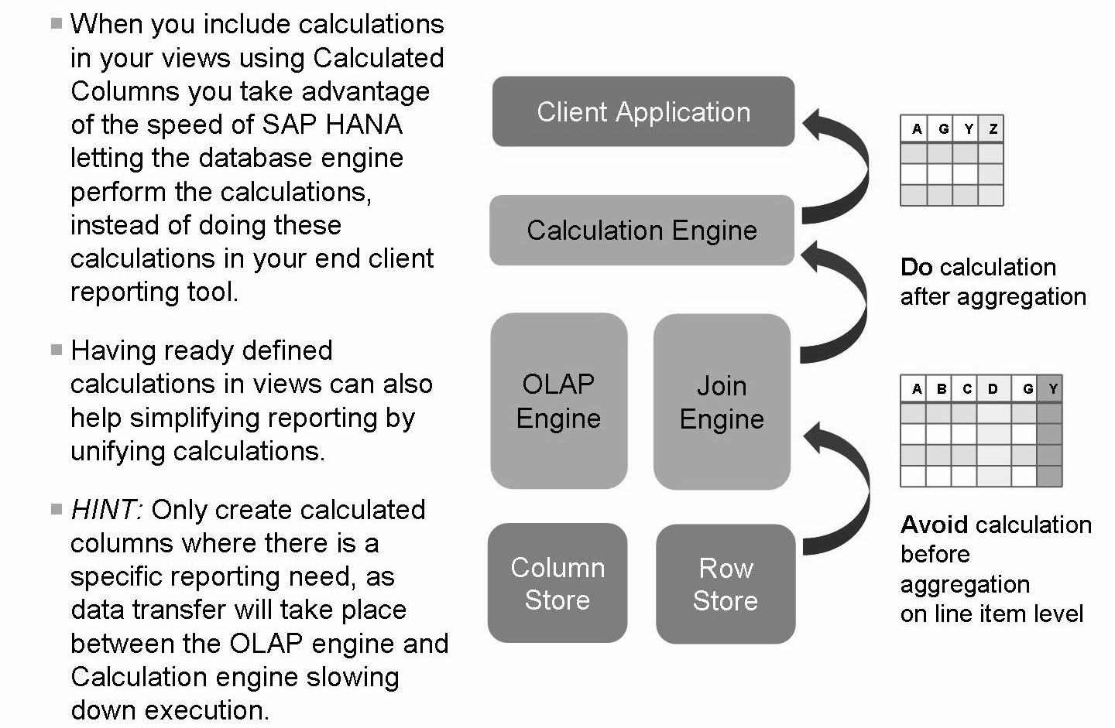
When to use Calculated Columns

Slide 12
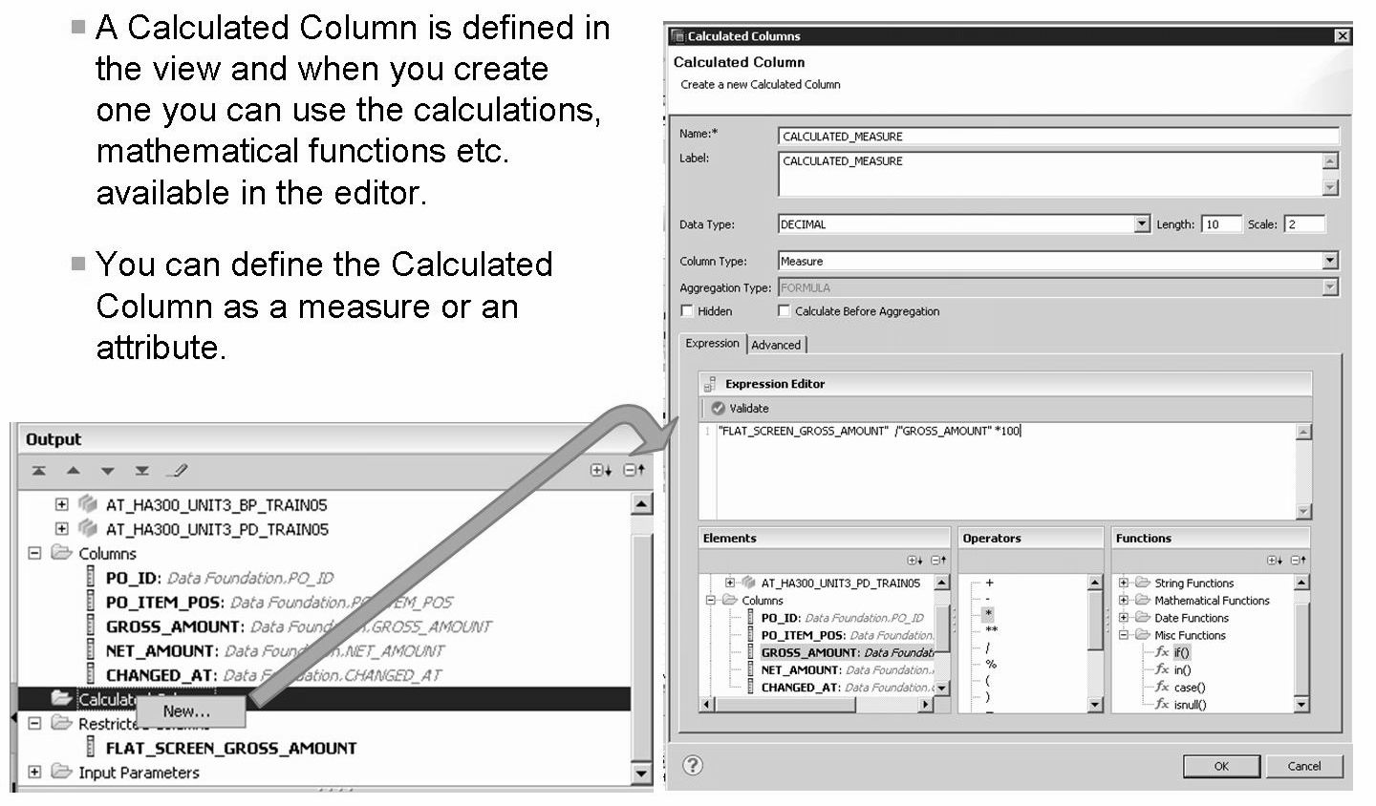
Creating Calculated Column
If you want to create a calculated measure and enable client side aggregation for the calculated measure, select the Enable client side aggregation checkbox.
This allows you to propose the aggregation that client needs to perform on calculated measures.

Slide 13
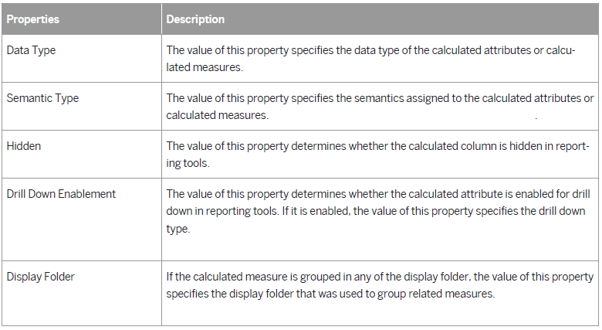

Slide 14
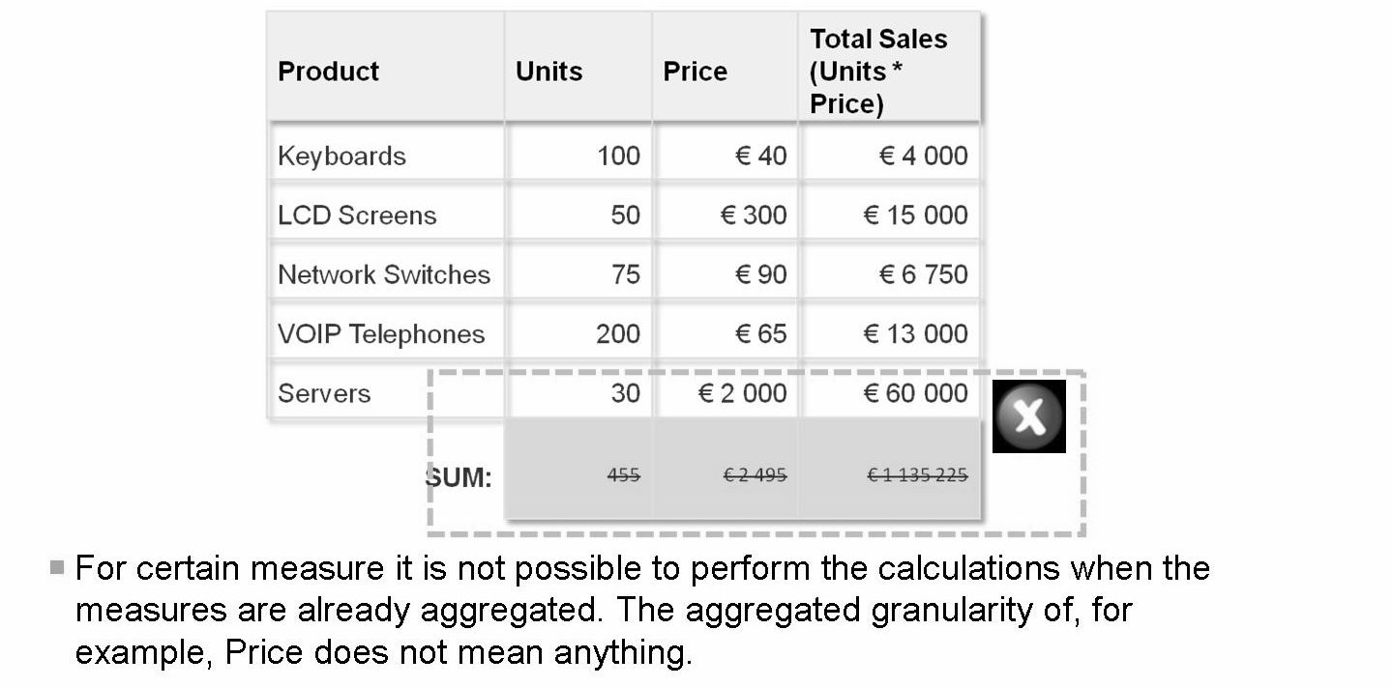
Consider granularity when creating calculated columns

Slide 15
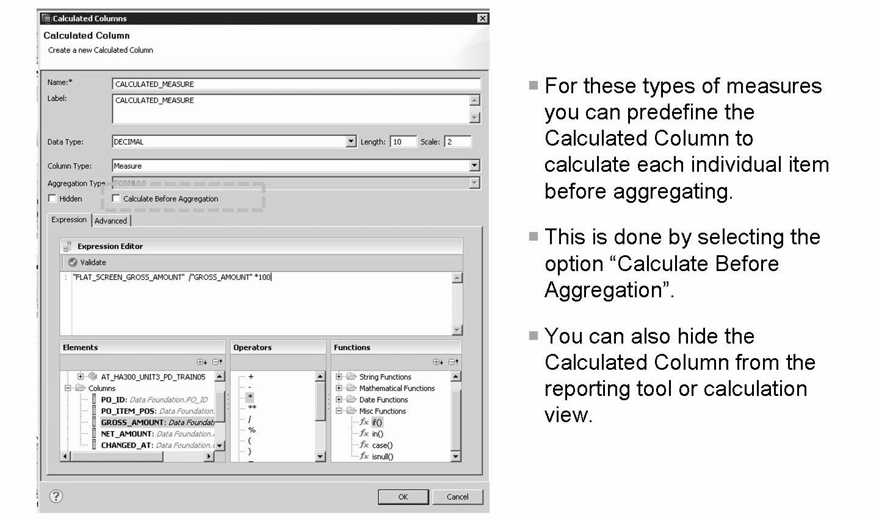

Slide 16
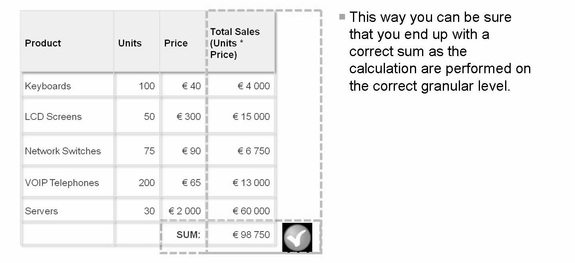
Hint: Only use calculation before aggregation when required where they include for example multiplication or division. If the calculations are simple plus or minus operations it is not required, as it will slow down execution.

Slide 17
If you are not able to activate your information view because of name conflicts between shared and local attributes of a column view, then you can use aliases to resolve such conflicts and activate the information view. Select the semantics node and in the Shared Attribute pane, provide Alias Name and Alias Label values.
If there are more than one table in the data foundation node, specify the central table (fact table) from which the modeler must derive the measures. Select the Data foundation node and define the property, Central Entity in the Properties pane.
Self-joins are not supported. While creating joins, ensure that a table does not appear twice in any join path. A join path is the set of joins that links the fact table to other tables.
While creating joins between analytic view and attribute view:
The same table cannot be used in the join path of analytic view and attribute view
The table of the attribute view which is linked to the fact table should not have an alias table
You can enable relational optimization for your analytic view using “Allow Relational Optimization” property.
Setting this property would be effective only for analytic views having complex calculations such that deployment of analytic view generates catalog calculation view on top of the generated catalog OLAP view.
In this case, if this flag is set counters and SELECT COUNT may deliver wrong results
While modeling an analytic view, if you have also opened and edited an attribute view that is used in the analytic view, then close and reopen the analytic view editor to see any changes that you have made to the attribute view.

Slide 18
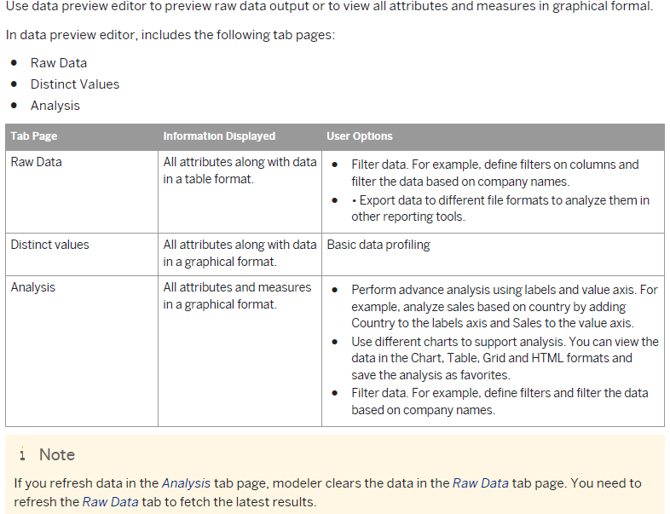
Data Preview Editor

Slide 19
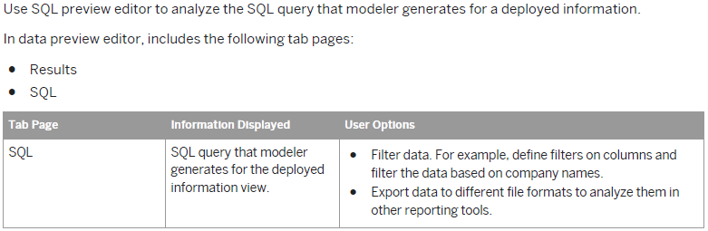
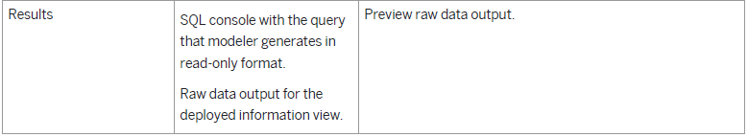
SQL Editor

Slide 20
THANK YOU

